Slide 1
Contact Manager App
fljdsf

Slide 2
Members
Yuri Rubio
Peter Castro
Amanda Gilliam
Christian Jaimes
Sergio Perez
Eoin Reilly

Slide 3
How it was made
MERN Stack
Mongo CB, Express, REACT, Node.js
Hosted by:

Slide 4
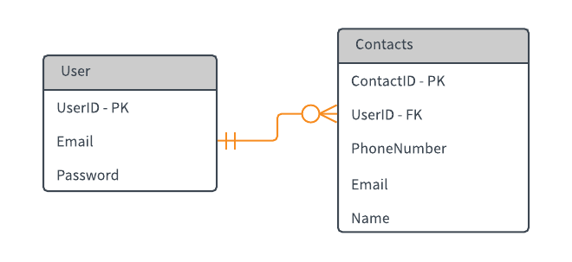
ERD

Slide 5
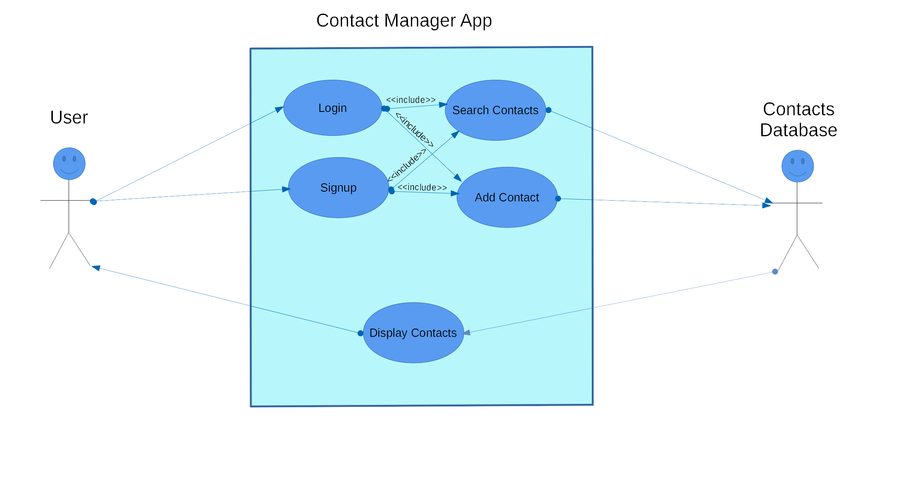
Uml: Use case diagram

Slide 6
DEMO

Slide 7
Questions?

